Slide 1
Anatomy of Communal politics, 1912-1935 Saleh Shahriar, PhD. North South University Dhaka, Bangladesh ORCID: https://orcid.org/0000-0001-5199-3258

Slide 2
Historical Background :
Hindu–Muslim relations in the context of the Annulment of the Partition of Bengal ,1911
First World War, 1914-1918
Economic crises
Increase of Jute Price & well-being of the Bengal peasants
Establishment of the Dhaka University , 1921
Prior to the Great Depression of 1930s

Slide 3
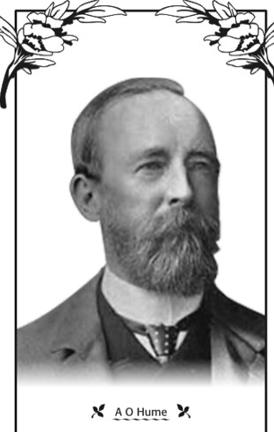
Indian National Congress Founded in 1885 by a narrowly based national elite, the Indian National Congress (INC) gradually transformed into a broad-based nationalist organization from the beginning of the 20th century. The Congress was founded by Allan Octavian Hume (A.O. Hume) who was a former home secretary of India.
Professor K.B. Sayeed in his book, entitled, Pakistan: The Formative Phase, has infomed that the formation of the Indian National Congress was largely inspired by British influence (Source: Khalid bin Sayeed, Pakistan: The Formative Phase, 1960,Oxford University Press, page:29).

Slide 4
All India Muslim League (AIML) established in December 1906, initially led by Aga Khan and ultimately by Muhammed Ali Jinnah, was instrumental in creating public opinion in favor of Muslim nationalism and finally in achieving Pakistan in 1947.
The background of the foundation of the Muslim League at Dhaka on 30 December 1906 may be traced back to the establishment of the Indian National Congress in 1885. The Western educated Hindu elite with the objectives of sharing power with the raj and motivating it to establish representative government in India established the Congress.

Slide 5
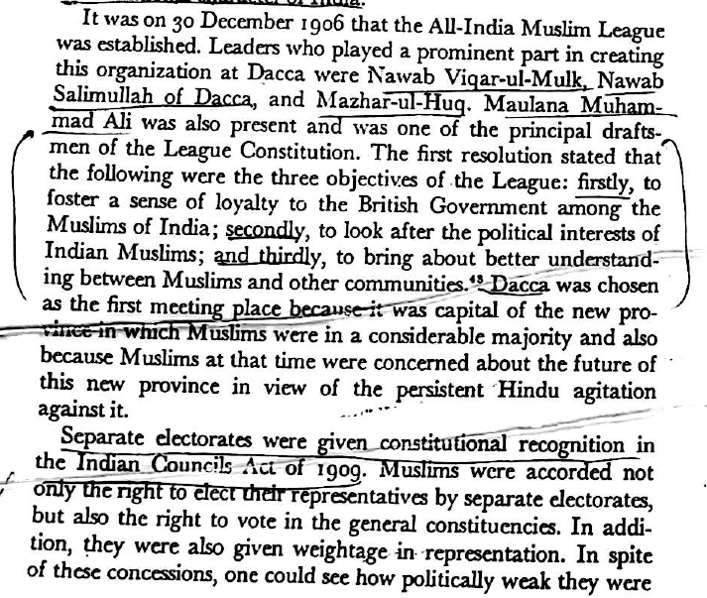
Three Specific Objectives of the AIML:

Slide 6
During the Partition of Bengal (1905-11) the bitterness between the Hindus and Muslims was further accentuated. Communal bitterness was so intense that “by 1905 the building blocks which eventually went into the making of Pakistan were already there"
Muslims achieved separate electorates in 1909, as well as a national Muslim organization - the Muslim League – and several vocal Muslim representatives in the Legislative and Executive Councils, Syed Nawab Ali Chudhuri, Nawab Syed Shamsul Huda, A. K Fazlul Huq and Nawab Khwaja Salimullah of Dhaka. ( Source: Taj Hashmi, Pakistan as a Peasant Utopia: The Communalization of Class Politics in East Bengal, 1920-1947; London, Routledge: Taylor & Francis, 1992)

Slide 7
The Lucknow Pact was an agreement reached between the Indian National Congress and the Muslim League at a joint session of both the parties held in Lucknow in December 1916
Muhammad Ali Jinnah as the ambassador of Hindu-Muslim unity

Slide 8
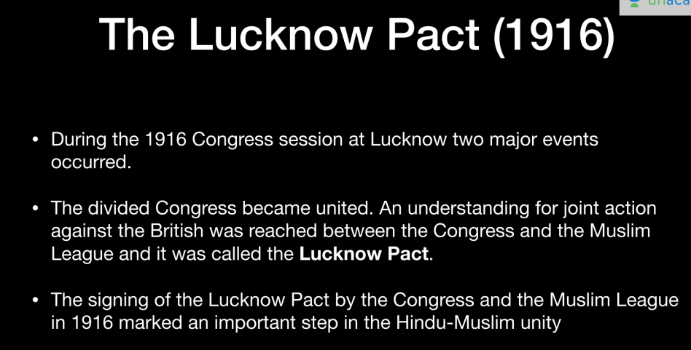

Slide 9
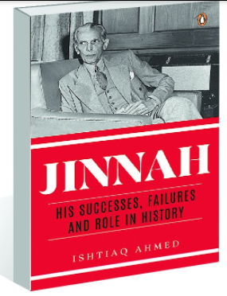
Professor Ishtiaq Ahmed in his latest book, titled, Jinnah: His Success, Failures and Role in History (2020) commented, “The Lucknow Pact was proof of Jinnah’s outstanding leadership qualities”.

Slide 10
The Government of India Act, 1919 / Montagu-Chelmsford reforms, 1919

Slide 11
The Government of India Act of 1919:
On august 20, 1917, the British government declared for the first time, that its objective was the gradual introduction of responsible government in India.
Diarchy was introduced at the Provincial Level. Diarchy means a dual set of governments; one is accountable, the other is not accountable. Subjects of the provincial government were divided into two groups. One group was reserved, and the other group was transferred. The reserved subjects were controlled by the British Governor of the province; the transferred subjects were given to the Indian ministers of the province.

Slide 12
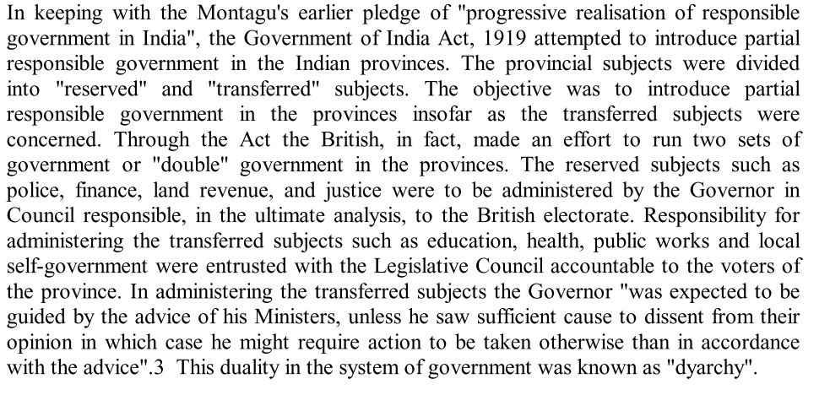

Slide 13
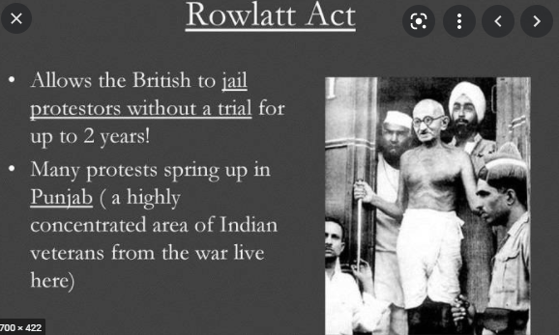
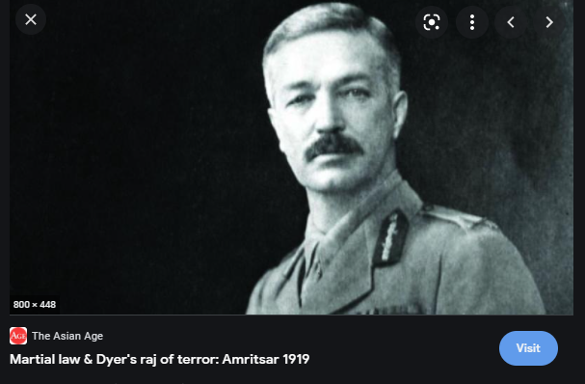
Rawlatt Act of 1919

Slide 14
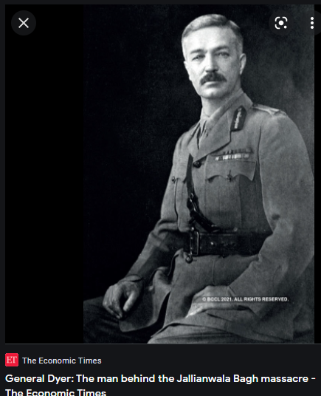
The massacre took place on 13 April 1919 when troops of the British Indian Army under the command of Colonel Reginald Dyer fired rifles into a crowd of Indians.

Slide 15
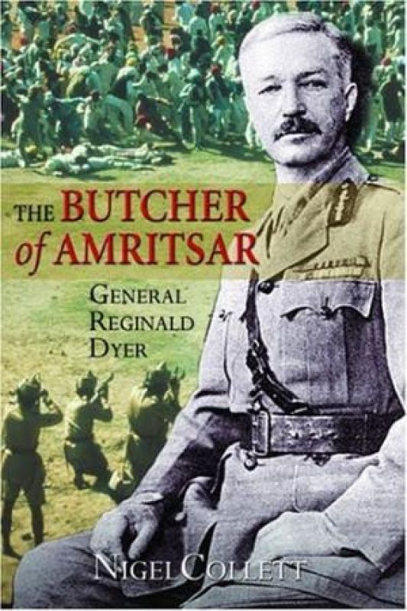
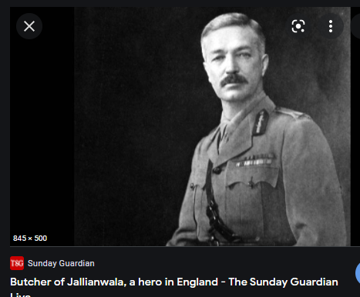

Slide 16
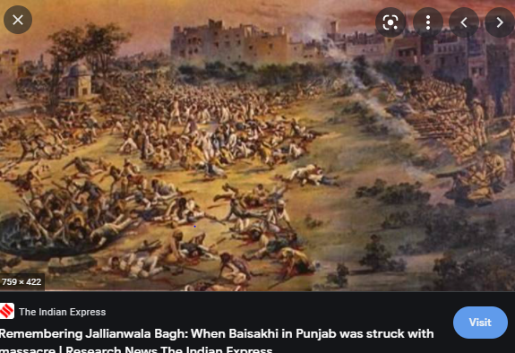
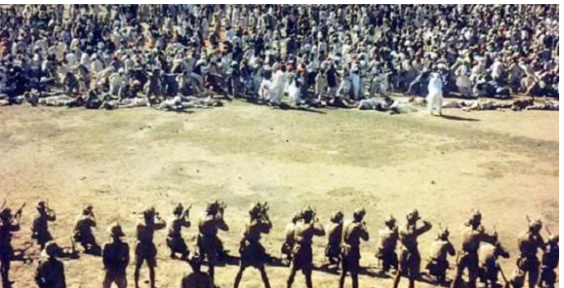
General Dyer ordered for mass shooting
Officially about 400 protesters died as a result of mass shooting and killings, 1200 wounded
Jallianwala Bagh Tragedy (জালিয়ানওয়ালাবাগ হত্যাকাণ্ড)

Slide 17
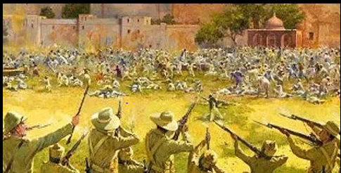

Slide 18
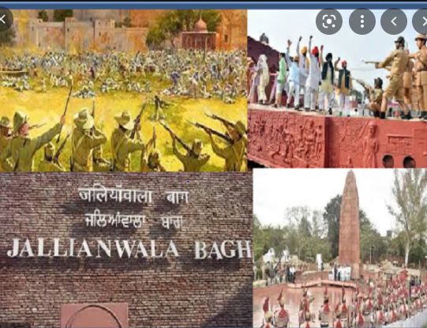

Slide 19
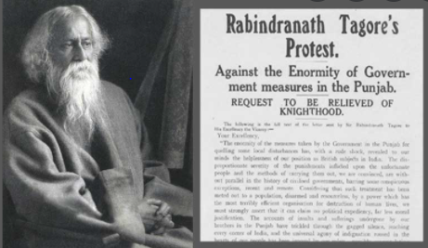
Jallianwala Bagh massacre in punjab forced people like Tagore to react and restricted them to enjoy the titles awarded by a brutal repressive power.

Slide 20
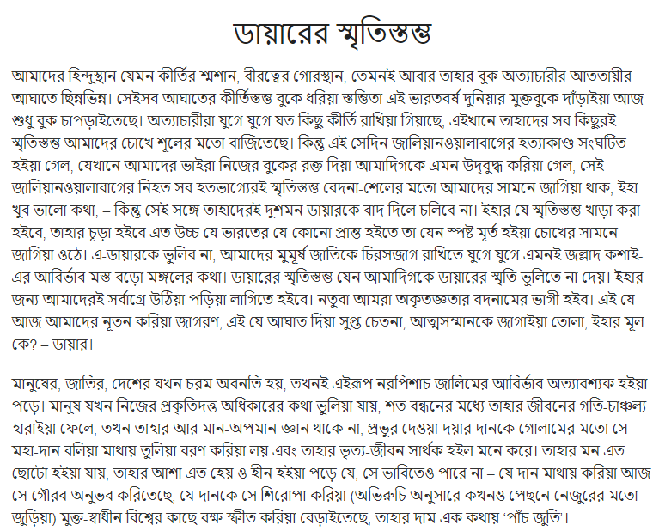
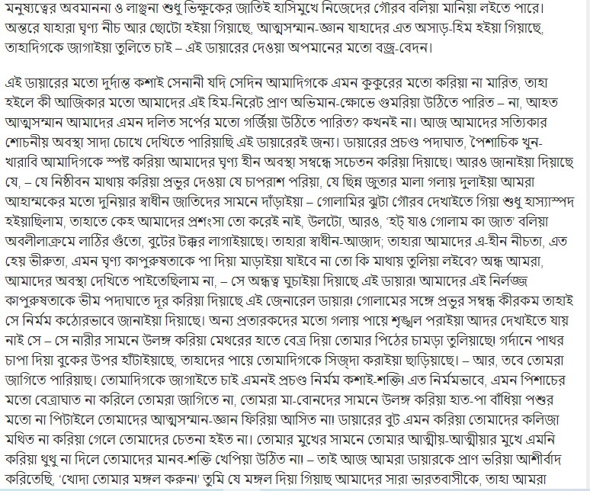
Kazi Nazrul Islam wrote an article:

Slide 21
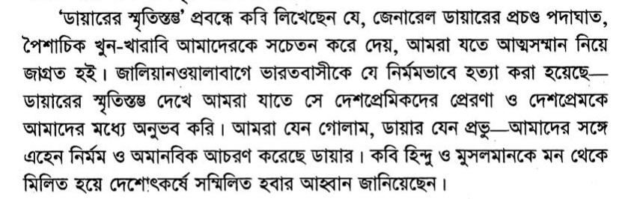

Slide 22
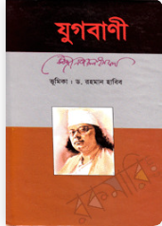

Slide 23
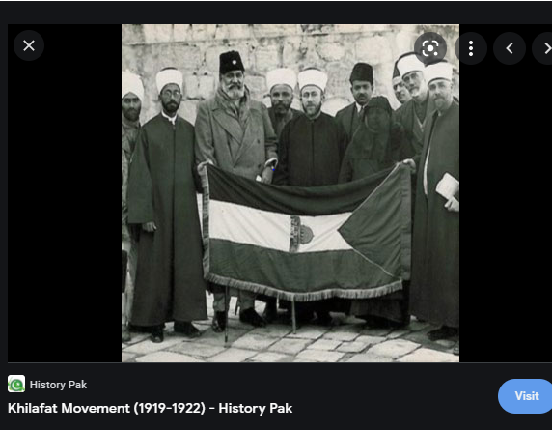

Slide 24
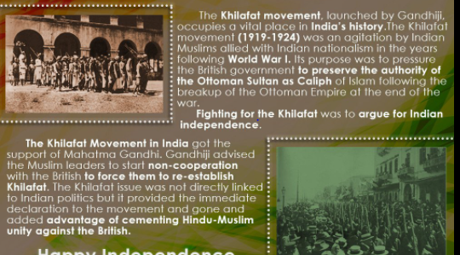

Slide 25
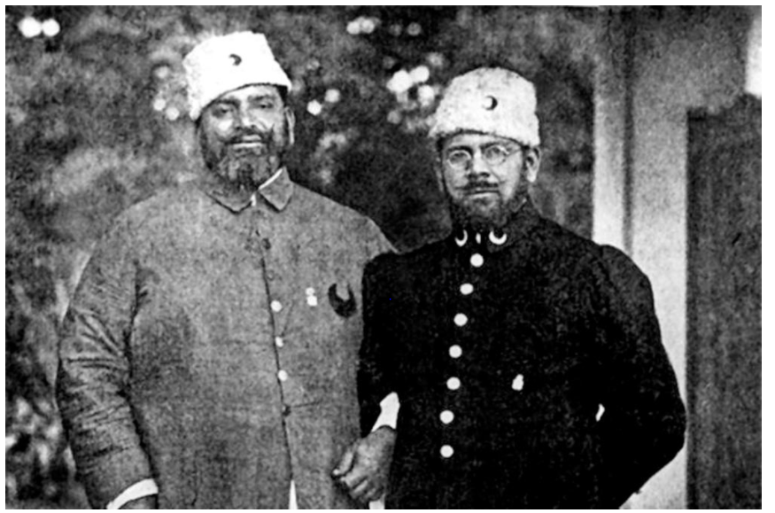
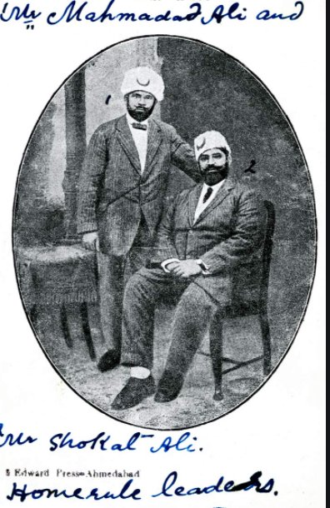

Slide 26
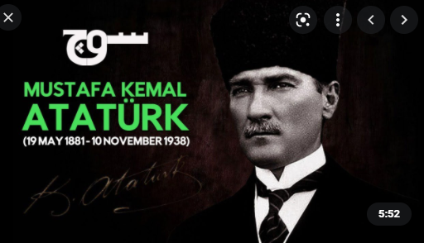

Slide 27
The Khilafat Movement (1919-1924) was an agitation by Indian Muslims allied with Indian nationalism in the years following World War I. Its purpose was to pressure the British government to preserve the authority of the Ottoman Sultan as Caliph of Islam following the breakup of the Ottoman Empire at the end of the war.

Slide 28
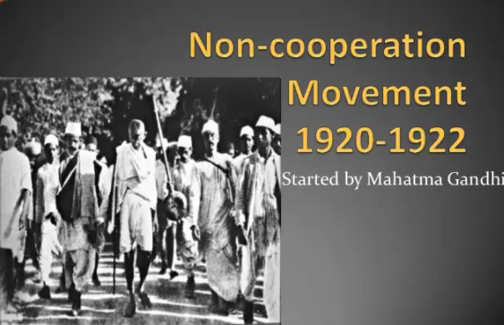

Slide 29
Hindu-Muslim Riots
Killings and rape
Violence
Blending of religion & politics

Slide 30
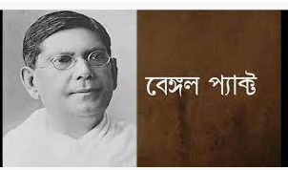

Bengal Pact, 1923 an agreement aimed at resolving the question of Hindu-Muslim differences. Chitta Ranjan Das, a man of vision who sincerely believed in the principle of sharing political power with the majority Muslim community of the province, came forward to take up the task of strengthening relations between Hindus and Muslims.

Slide 31
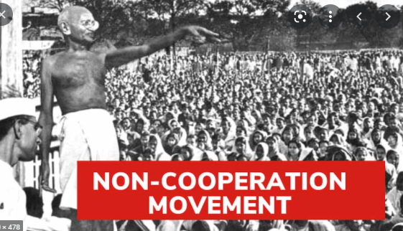
Non-Cooperation Movement

Slide 32

The Communal Award, announced by Ramsay MacDonald on 16 August 1932, ensured the retention of separate electorates for Muslims, Sikhs and Europeans and extended the separate electorate to depressed Classes (now known as the Scheduled Caste) and other minorities.

Slide 33
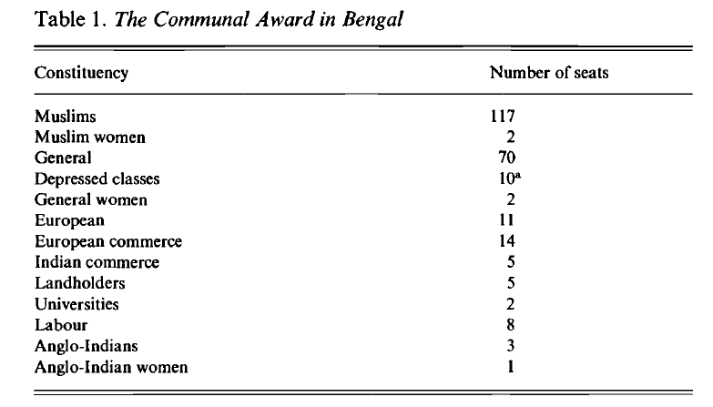

Slide 34
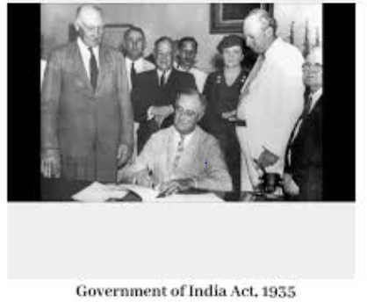

Slide 35
The Government of India Act of 1935
The provision of provincial autonomy was introduced in the Government of India Act of 1935
The Act of 1935 provided for the establishment of an All-India Federation consisting of provinces and princely states as units. The Act divided the powers between the Centre and units in terms of three lists—Federal List (for Centre, with 59 items), Provincial List (for provinces, with 54 items) and the Concurrent List (for both, with 36 items). Residuary powers were given to the Viceroy. However, the federation never came into being as the princely states did not join it.

Slide 36
Conclusions: Communal Politics & its Future Implications :
Provincial Election of 1937 based on the constitution of 1935
Sher-e-Bangla AK Fazlul Hoque and formation of the Krishak Proja Party
Lahore resolution of Jinnah , 1940
Hindu-Muslim riots ( For example, The Great Calcatta Killings)
Mass migration
From the demand of Separate electorate (1906/1909/1916/1919/1923/1932/1935) to the emergence of Separate states like India and Pakistan in 1947

Slide 37
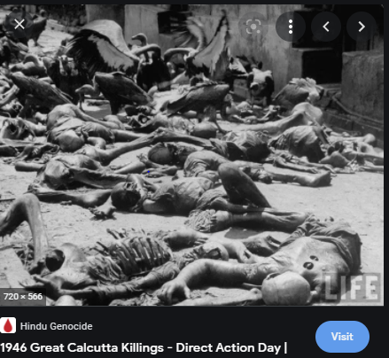

Slide 38
References:
Harun-or-Rashid, The Foreshadowing of Bangladesh: Bengal Muslim League and Muslim Politics, 1936-1947
K.B.Sayeed, Pakistan: The Formative Phase, 1857-1948
Taj Hashmi, Pakistan as a Peasant Utopia: The Communalization of Class Politics in East Bengal, 1920-1947
Ishtiaq Ahmed, Jinnah: His Success, Failures and Role in History
Anindita Ghoshal, Refugees, Borders and Identities: Rights and Habitat in East and Northeast India ( “Introduction” of this book is suggested).
আবুল মনসুর আহমদ, আমার দেখা রাজনীতির পঞ্চাশ বছর

